Slide 1

Digital Identity?
My Three Takeaways
Marco.Venuti@ThalesGroup.com
Notes:
Identity = attributes in context and community
Digitalization of society and commerce.
Your identity is the gateway to your interaction.
Importance of securing digital identity increases.
Evolving to identity-centric security controls.
(We observe, we see change, we see winners doing …)

Slide 2

So many different Identity Conversations….
Driver
Compliance Pressure
Digital Reputation
Operational Efficiency
Security Posture
Lifecycle
Getting an Identity:
Registration, Validation, Consent…
Using Identities:
Authentication, Authorization, Governance
Persona
Employees
B2B Partners
Consumers
Admins

Slide 3
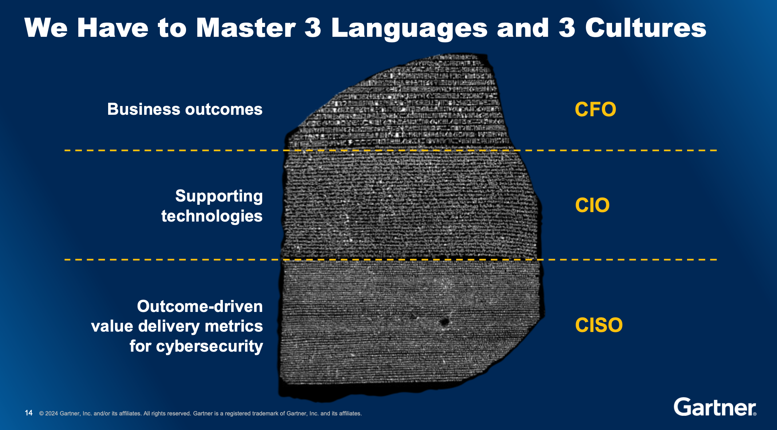
My three attention points
Overlapping reasons & the “Lost in Translation” effect: The stakeholders languages diversity

Slide 4
My three attention points
Overlapping reasons & the “Lost in Translation” effect: The stakeholders languages diversity
The Approach: Make vs Buy? Best-of-Breed vs Best-of-Suite?

Slide 5



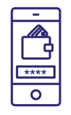
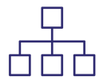


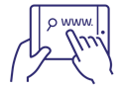



Register
Bring your own
Authenticate
Authorize
Delegate
Consent
Preferences
Access
Forget
Proof
LEAVE
USE
LOG IN
SIGN UP
EXPLORE
CONSIDER
PURCHASE
USE
ABANDON

Slide 6
My three attention points
Overlapping reasons & the “Lost in Translation” effect: The stakeholders languages diversity
The Approach: Make vs Buy? Best-of-Breed vs Best-of-Suite?
The “We Are Unique” effect – Business process changes vs deeper customization attitude

Slide 7
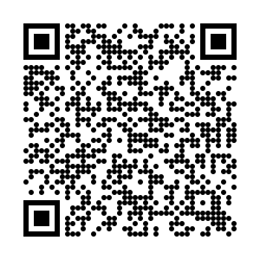
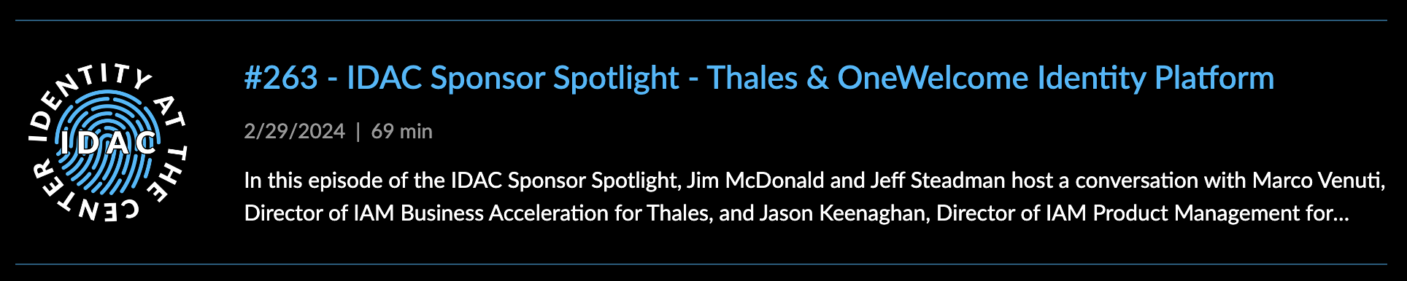
Grazie
Marco.Venuti@ThalesGroup.com

